Slide 1


QOE-AWARE RESOURCE ALLOCATION TECHNIQUES FOR FOG COMPUTING
MEMBERS : M.Aarthy(201606001)
N.C.Karthigaa(201606027)
T.Madhumitha(201606031)
GUIDE : Mrs. S.Saroja, M.E.,(Ph.D)
Department of Information Technology
Mepco Schlenk Engineering College
Department of IT

Slide 2

Problem Statement
No first aid and other medical services in harsh regions.
Distant communication and transportation problems.
Department of IT

Slide 3

Objective
Immediate first aid.
Resolve unreliable connectivity issues.
Better service quality
Prevent underutilization of resources
Department of IT

Slide 4
Introduction
Key Concepts
  Fog computing
  Cloud computing
  Haptic interfaces
  Quality of Experience
  Quality of Service
Department of IT

Slide 5

Department of IT

Slide 6

Department of IT

Slide 7
Cloud vs Fog
 | Cloud Computing | Fog Computing
Architecture Data processing Computing capabilities Latency Security | Centralized Far from the source of information Bigger High Weaker | Distributed Close to the source of information Smaller Low Strongest
Department of IT

Slide 8

Haptic Interfaces
Department of IT

Slide 9
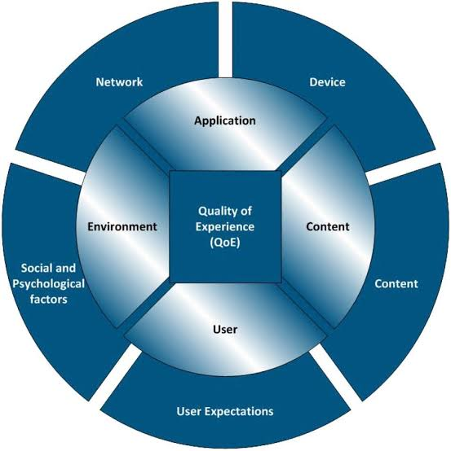
Quality of Experience
Department of IT

Slide 10

Department of IT

Slide 11
Literature Survey
R1
Title: 5G –enabled Tactile Internet
Year: 2016
Author: M. Simsek, A. Aijaz, M. Dohler, J. Sachs, and G.
Fettweis
Description: This paper outlines the key technical requirements and architectural approaches for the tactile internet.
Advantages: 5G provides better QOS and enables intelligent transportation systems and smart grid in an industrial environment.
Disadvantages: While this paper talks about the quality of service and it not discuss about the qoe factor on end user.
Department of IT

Slide 12
Contd..
R2
Title: Tactile Internet Applications and challenges
Year: 2014
Author: A. Aijaz
Description: This paper provides a survey of 5G and fog computing technologies.
Advantages: This paper talks about the real time interaction and haptic communication with the environment.
Disadvantages: This paper discuss only about the real time uses but it does not discuss about any of the QOS and QOE factors.
Department of IT

Slide 13
Contd..
R3
Title: 5G and the fog survey of related technologies and research directions
Year: 2016
Author: G. P. Fettweis
Description: This paper talks about the excellence of future internet of services such as 5G and fog computing.
Advantages: This paper talks about all the positives and possibility aspects of 5G network.
Disadvantages: This paper talks only about the basics of 5G and fog computing technologies.
Department of IT

Slide 14
Contd..
R4
Title: Sensor Technologies for intelligent transportation systems
Year: 2018
Author: J. Guerrero-Ibanez, S. Zeadally, and J. Contreras Castillo
Description: This paper discuss about transportation infrastructure to achieve a sustainable Intelligent Transportation System (ITS).
Advantages: This paper talks about the safety measures and pollution control in transportation.
Disadvantages: This paper discuss only about the sensing communications.
Department of IT

Slide 15
Contd..
R5:
Title: Multilevel cloud based tactile internet systems
Year: 2017
Author: A. A. Ateya, A. Vybornova, R. Kirichek, and
A.Koucheryavy
Description: This paper discuss about the multi-level cloud based cellular system.
Advantages: Introducing more levels of clouding reduces the round trip latency and the network congestion.
Disadvantages: It does not talk about the field in which the idea discussed is applied.
Department of IT

Slide 16
Comparison
R. No | Title | Adv of ref paper | Adv of our project
R1 | 5G enabled tactile internet | While this paper talks about only the QoS factor. | This paper discuss about both the Qos and Qoe factors.
R2 | Tactile internet application and challenges | This paper discuss about the real time uses of 5G technologies. | This paper discuss about all the real time uses and qos and qoe factors in 5G.
R3 | 5G and the fog survey of related technologies and research directions. | This paper talks only about the basics of 5G and computing technologies. | This paper discuss about the 5G technologies along with both the Qos and Qoe factors.
R4 | Sensor Technologies for intelligent transportation systems. | This paper discuss about the sensing communication and problems in transportation sector. | This paper gives modern solution to all the fields by using 5G and fog commuting technologies.
R5 | Multilevel cloud based tactile internet systems | It discuss about the conceptual idea of tactile internet systems but it does not talk about the field in which the idea discussed is applied. | This paper discuss about the implementation of fog computing in various field which will be more efficient than cloud computing.
Department of IT

Slide 17
Flow Diagram
FOG SELECTION
NPS RATIO CALCULATION
QOE RATIO ESTIMATION ALGORITHM
Department of IT

Slide 18
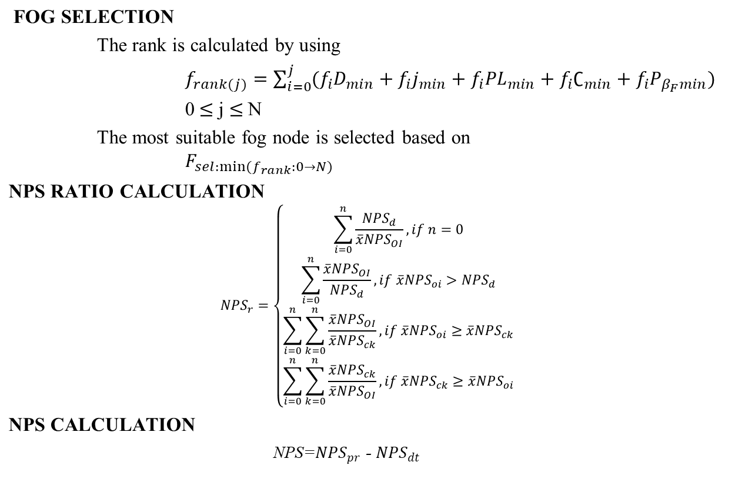
Module Explanation
Department of IT

Slide 19
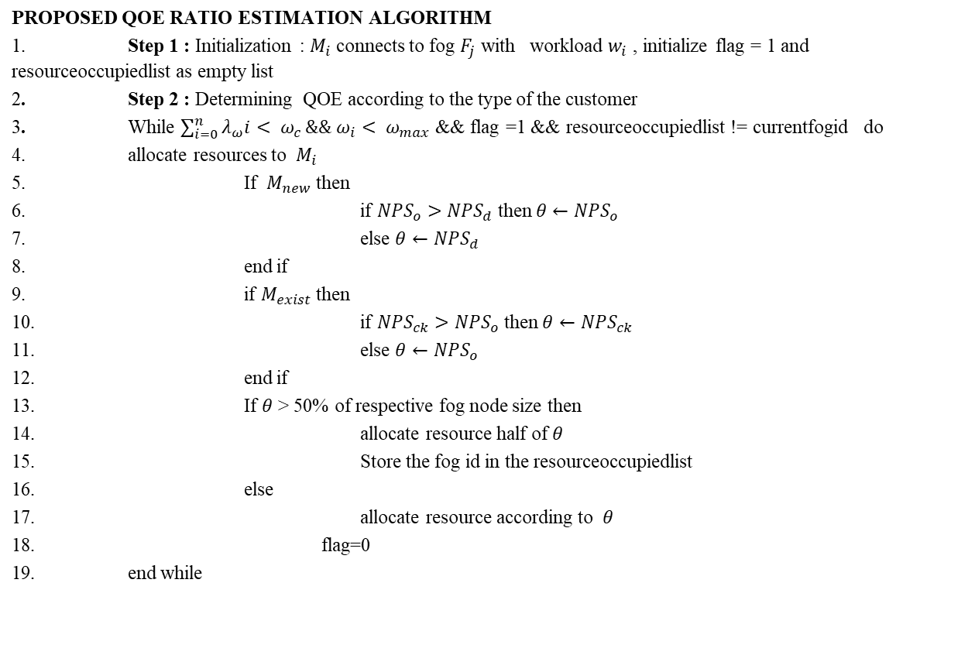
Department of IT

Slide 20



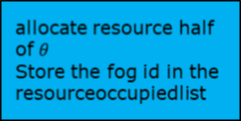
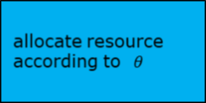
Enhancement
Advantages
  Reduces workload
  Reduces idle time
  Service provider profit increases
Department of IT

Slide 21
Source Code
C:\Users\user\passive\Desktop\project\sourcecode.docx
Department of IT

Slide 22
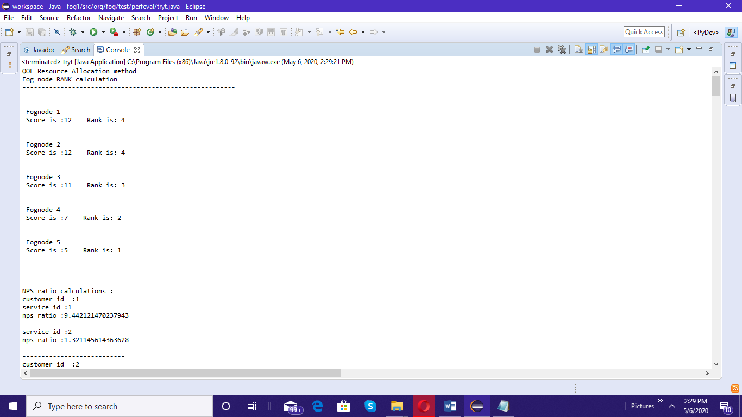
Output
Department of IT

Slide 23
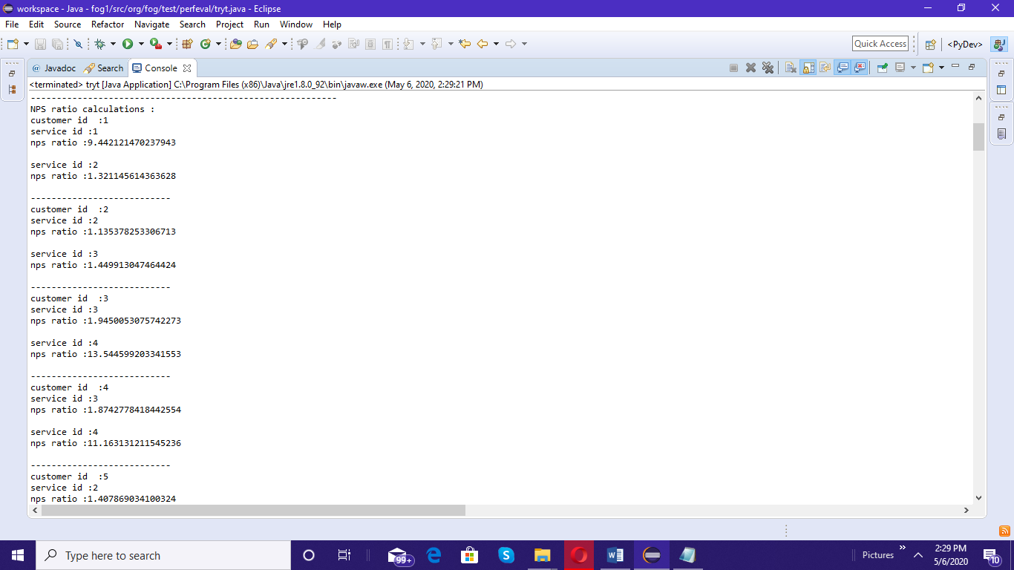
Contd..
Department of IT

Slide 24
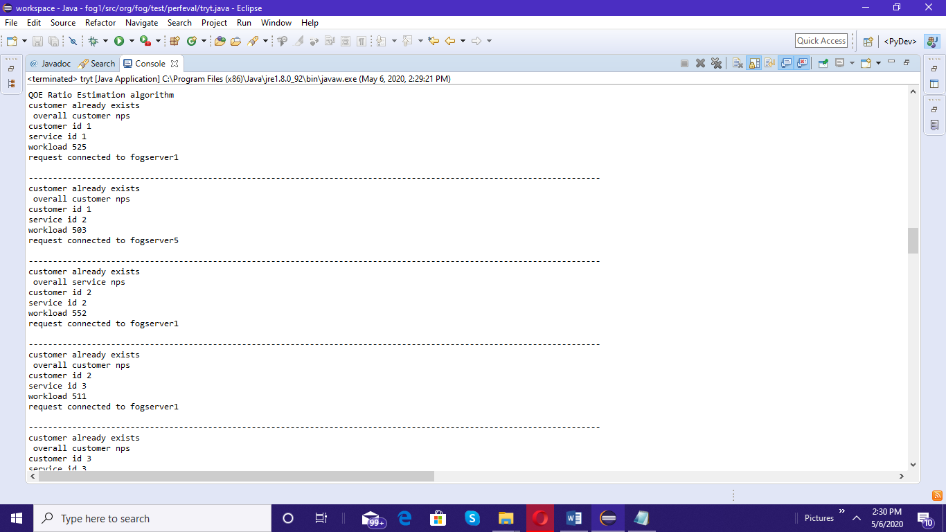
Contd..
Department of IT

Slide 25
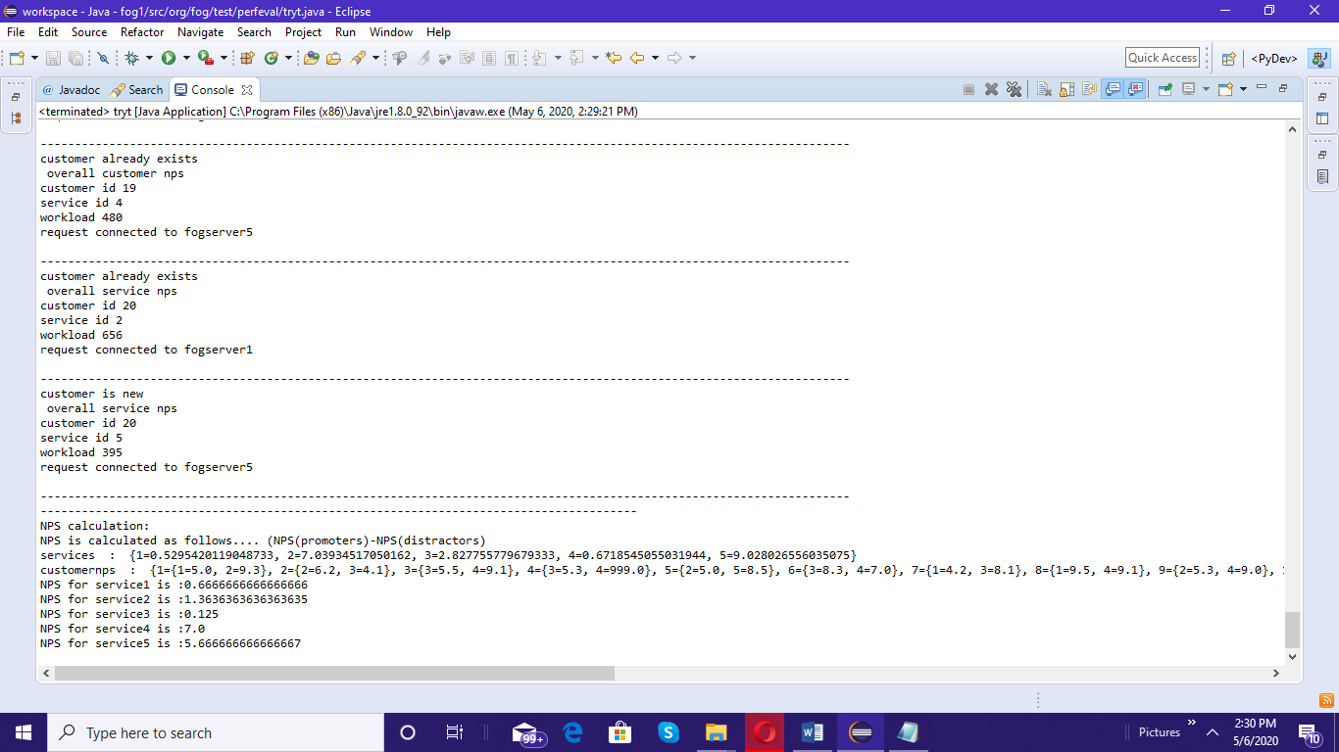
Contd...
Department of IT

Slide 26
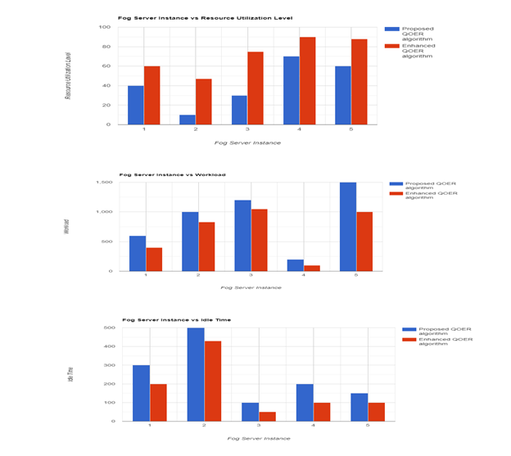
Performance Analysis
Department of IT

Slide 27




Conclusion
Dynamic resource allocation.
Improve the quality of service.
Provide better resource utilization.
Customer reliability.
Improved profit.
Department of IT

